Slide 1
Slide 11
Randomness
Dasar-Dasar Pemrograman 1
Semester Ganjil 2016/2017

Slide 2
Randomness
Random numbers are useful for running simulations in science, engineering, and finance.
They are needed in modern cryptographic protocols that provide computer security, communication privacy, and authentication.
They also are a necessary component in games of chance, such as poker or blackjack, and help make computer games less predictable.
Truly random numbers are not easy to obtain. Most computer applications that require random numbers use numbers generated by a pseudorandom number generator instead.
Dasar-Dasar Pemrograman Ganjil 2016-2017

Slide 3
Pseudorandom
The “pseudo” in “pseudorandom” means fake, or not real.
Pseudorandom number generators are programs that produce a sequence of numbers that “look” random and are good enough for most applications that need a random numbers.
In Python, pseudorandom number generators and associated tools are available through the random module
import random
Dasar-Dasar Pemrograman Ganjil 2016-2017

Slide 4
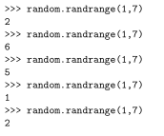
Random Integer
We can use function randrange()
The function takes a pair of integers a and b and returns a number in the range from—and including—a up to—and not including—b
Example:
Dasar-Dasar Pemrograman Ganjil 2016-2017

Slide 5

Random Float
We can use function uniform()
The function uniform() takes two numbers a and b and returns a float number x such that a≤x≤b (assuming a≤b).
Example:
Dasar-Dasar Pemrograman Ganjil 2016-2017

Slide 6
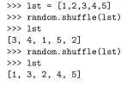
Shuffling
We can shuffle objects in a sequence (e.g. a list) with function shuffle()
Example:
Dasar-Dasar Pemrograman Ganjil 2016-2017

Slide 7
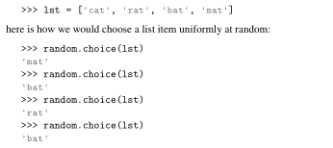
Choosing
We can choose an object from a sequence (e.g. a list) randomly with function choice()
Example:
Dasar-Dasar Pemrograman Ganjil 2016-2017

Slide 8
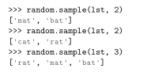
Sampling
We can choose some objects/get a sample from a sequence (e.g. a list) randomly with function sample()
Example:
Dasar-Dasar Pemrograman Ganjil 2016-2017

Slide 9
References
William Punch & Richard Enbody. The Practice of Computing using Python, 2nd Edition. Addison-Wesley, 2013
Y. Daniel Liang. Introduction to Programming Using Python. Prentice Hall, 2013.
John Zelle. Python Programming: An Introduction to Computer Science, 2nd Edition. Franklin, Beedle & Associates Inc., 2010.
Dasar-Dasar Pemrograman Ganjil 2016-2017

